Slide 1

Passenger’s flight Model
Forecasting the demand for flight tickets of an airline.
Presented By: Olawale Charles

Slide 2
Outlines
Background
Methodology
Dataset
Process
In-sample forecast
Out-sample forecast
Model evaluation
Conclusion

Slide 3

Background
Airline need to know when to lower or increase their ticket prices to obtain good margins.
We want to build a model to forecast the demand for flight tickets of a particular airline.

Slide 4
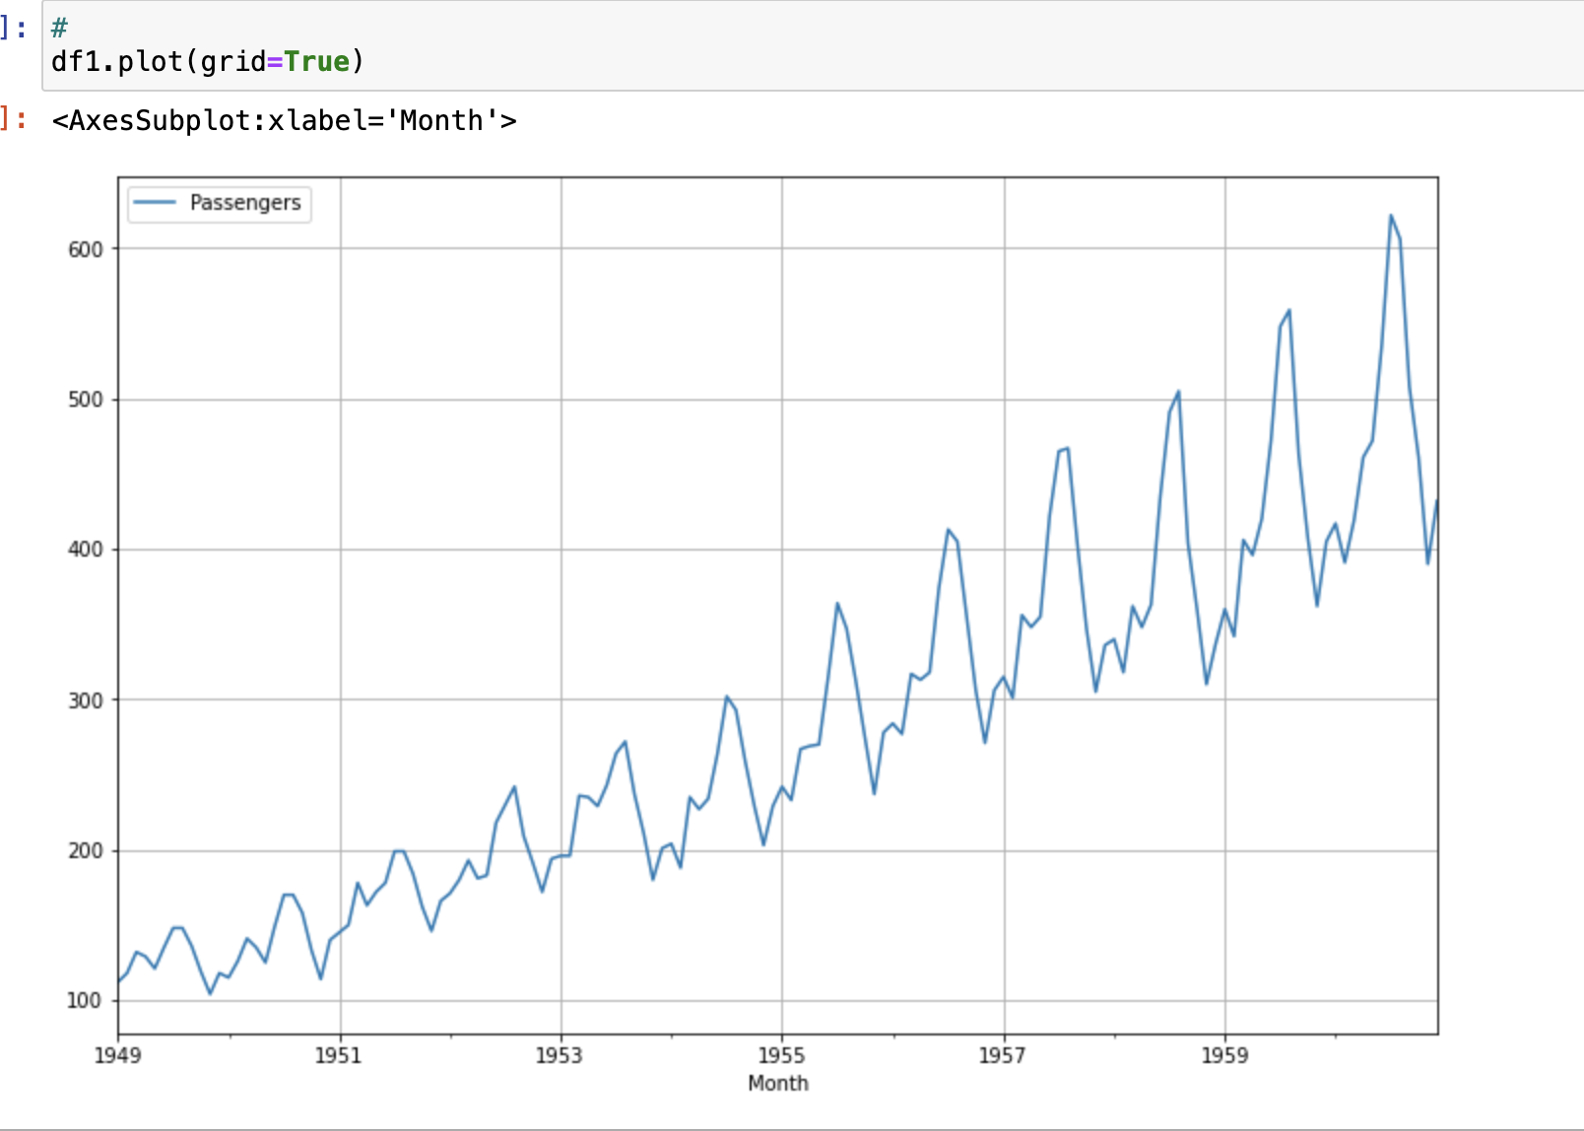
Methodology: Dataset
Dataset has two attributes
Date (January, 1949 – December 1960)
Number of passenger In thousand
144 rows
No missing values
No Outlier
Python was used for the analysis
American airline (www.kaggle.com)
Notes:
It is a standard univariate time series dataset that contains both a trend and seasonality, we observe from the plot that as years goes up the number of passengers increase, we could see peaks which could subject to trends. We are going to build a forecasting model to predict both in-sample and out-sample forecast.

Slide 5
Methodology: Process
Load data
Prophet library
Checks & cleaning
In-Sample Forecast
NA
Outliers
Trends
Out-sample Forecast
Model Evaluation
Install libraries
Notes:
in-sample forecasting evaluates how well a model fits the historical data it was trained on, while out-of-sample forecasting assesses a model's ability to make accurate predictions on new and unseen data. Both perspectives are crucial for a comprehensive evaluation of a predictive model's performance

Slide 6
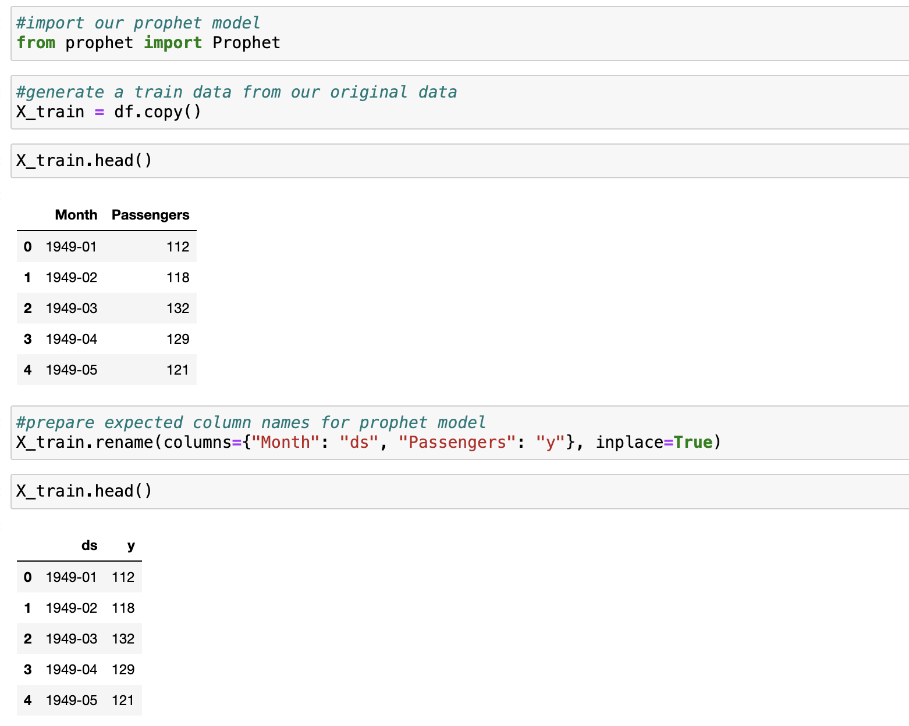
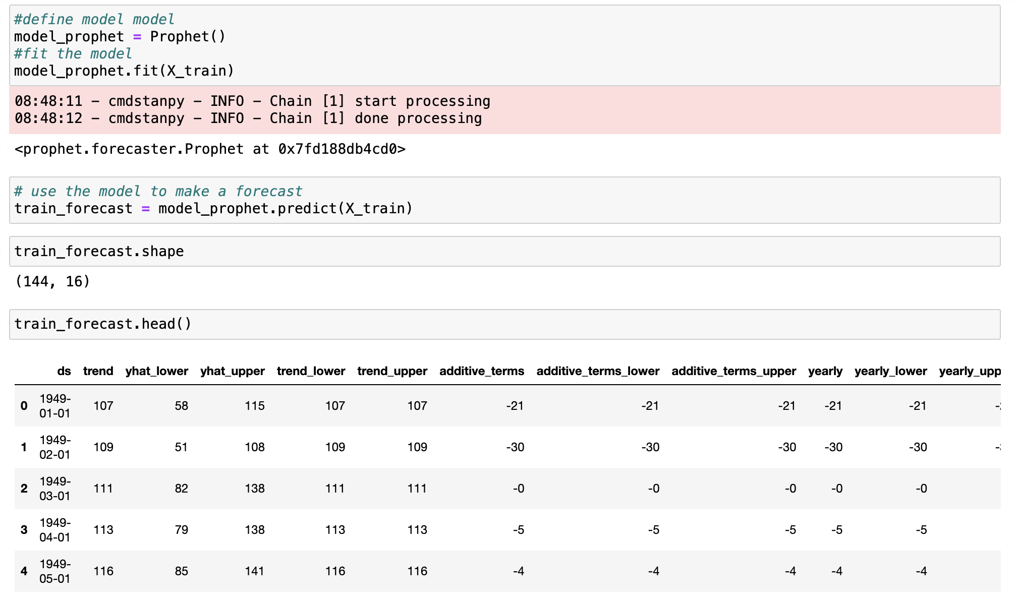
Methodology: Process
In-sample forecast

Slide 7
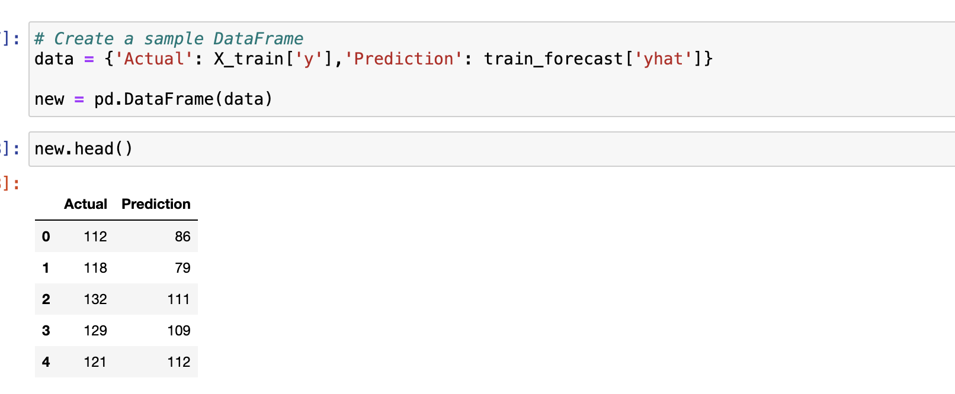
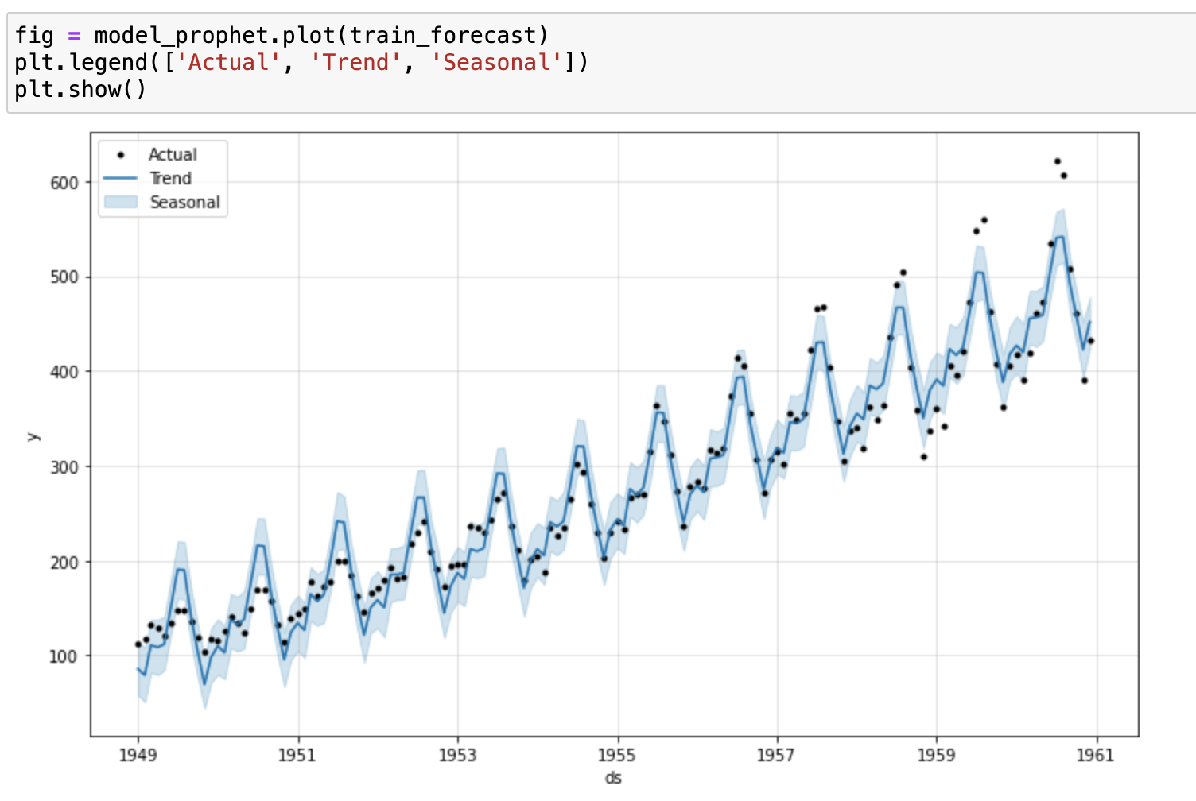
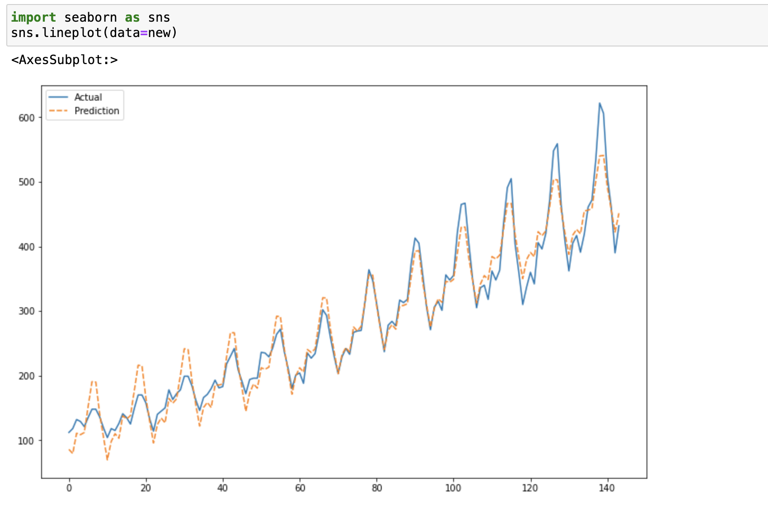
Methodology: Process
In-sample forecast
Notes:
We can clearly see that our model captures the general trend of our training data quite well. Besides that, we can see up and down passenger numbers which are caused by the yearly trend.

Slide 8
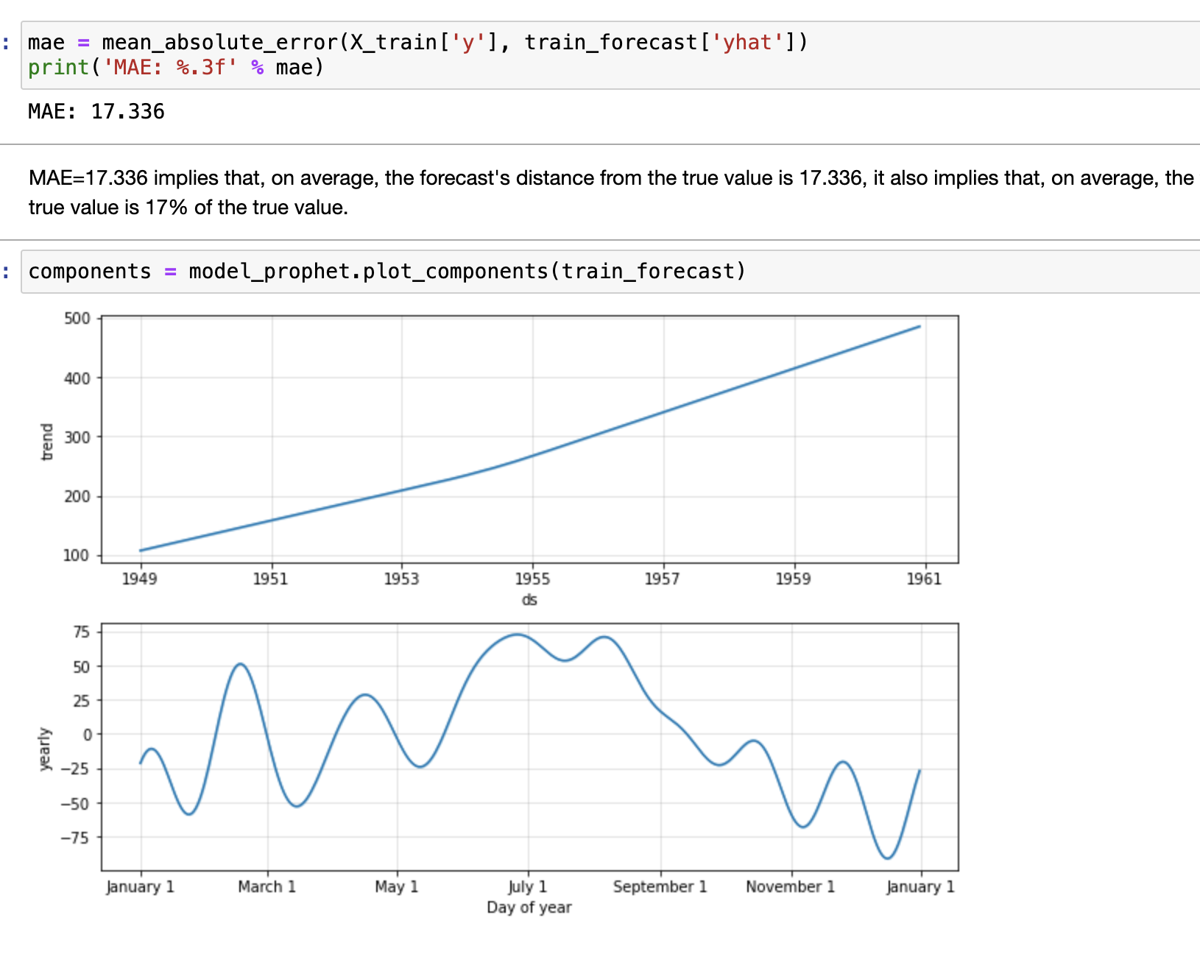
Methodology: Process
Mean absolute error (17.336)
Notes:
MAE=17.336 implies that, on average, the forecast's distance from the true value is 17.336, it also implies that, on average, the forecast's distance from the true value is 17% of the true value.
We can also see in the month of July that we have the highest numbers of passengers all through the years and January been lowest based on number of passengers. From the plots, the airline can know when to increase or lower the price of airline tickets to obtain a good margin.

Slide 9
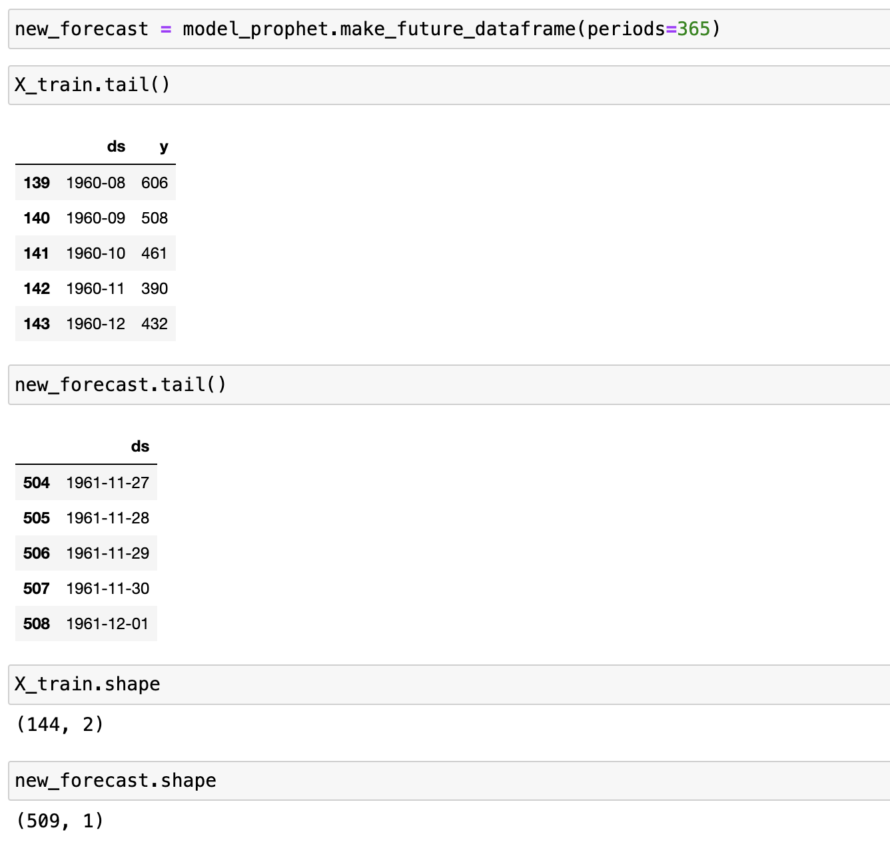
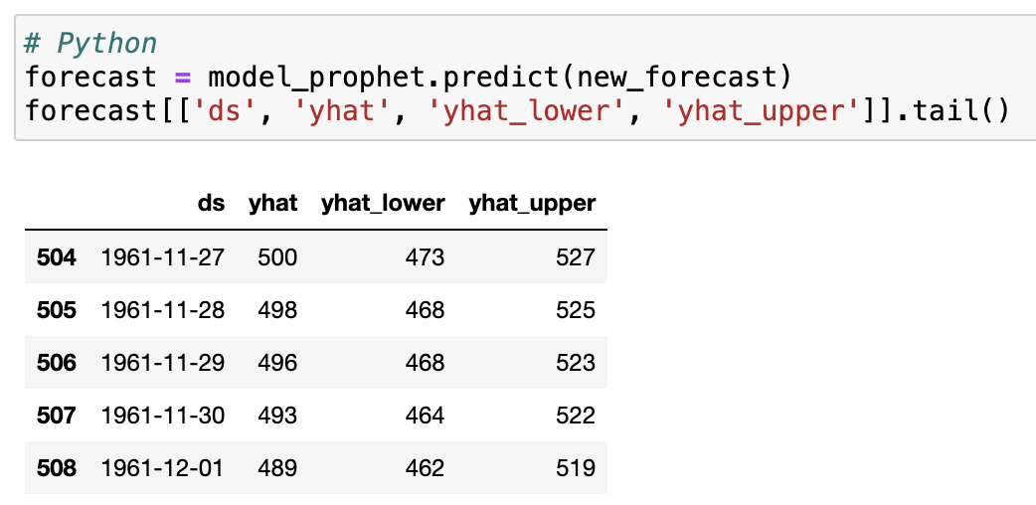
Methodology: Process
Out-sample forecast

Slide 10
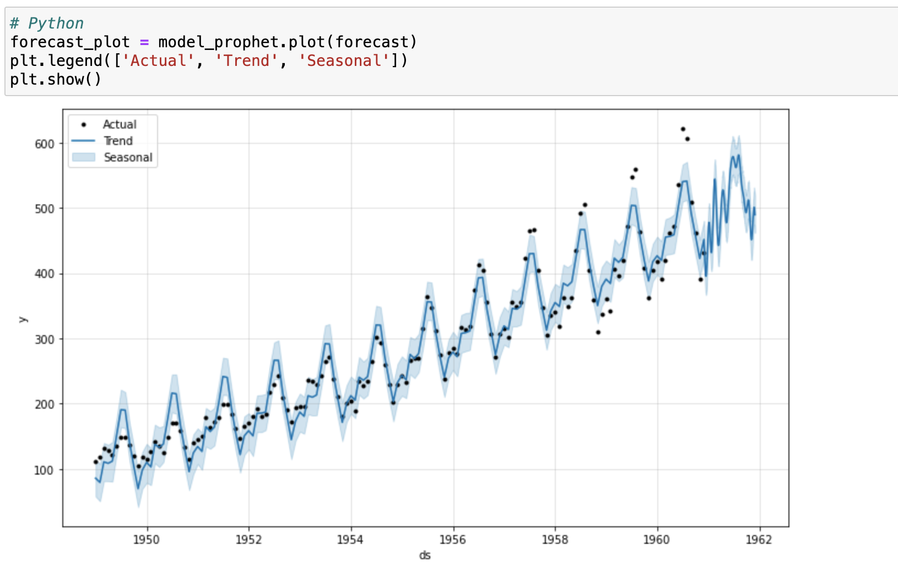
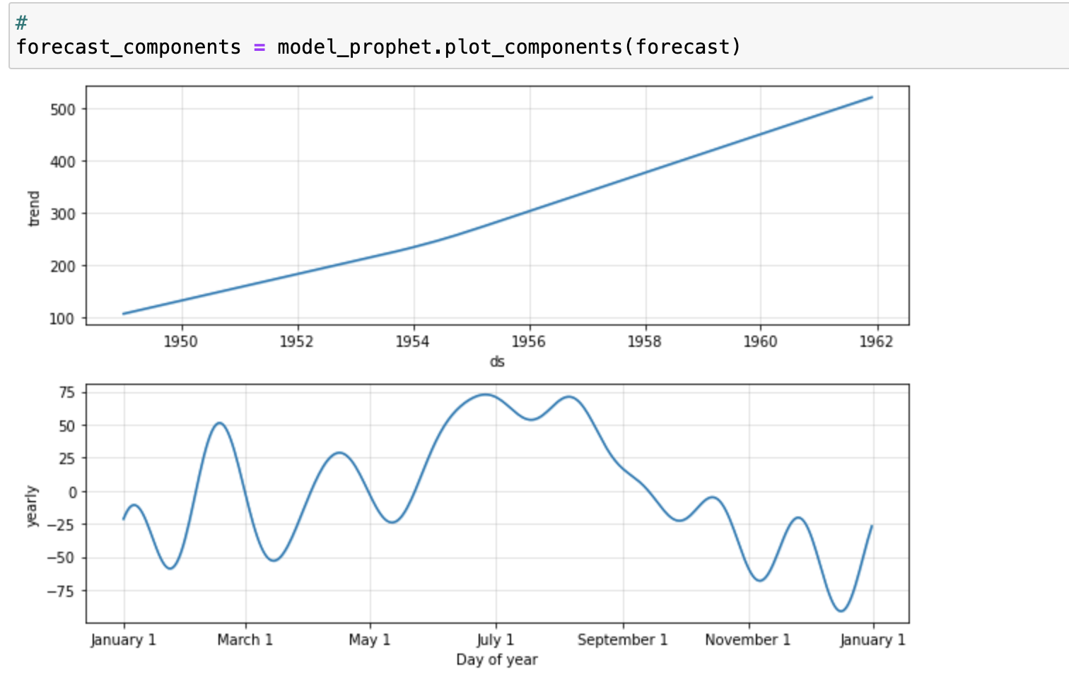
Methodology: Process
Out-sample forecast

Slide 11
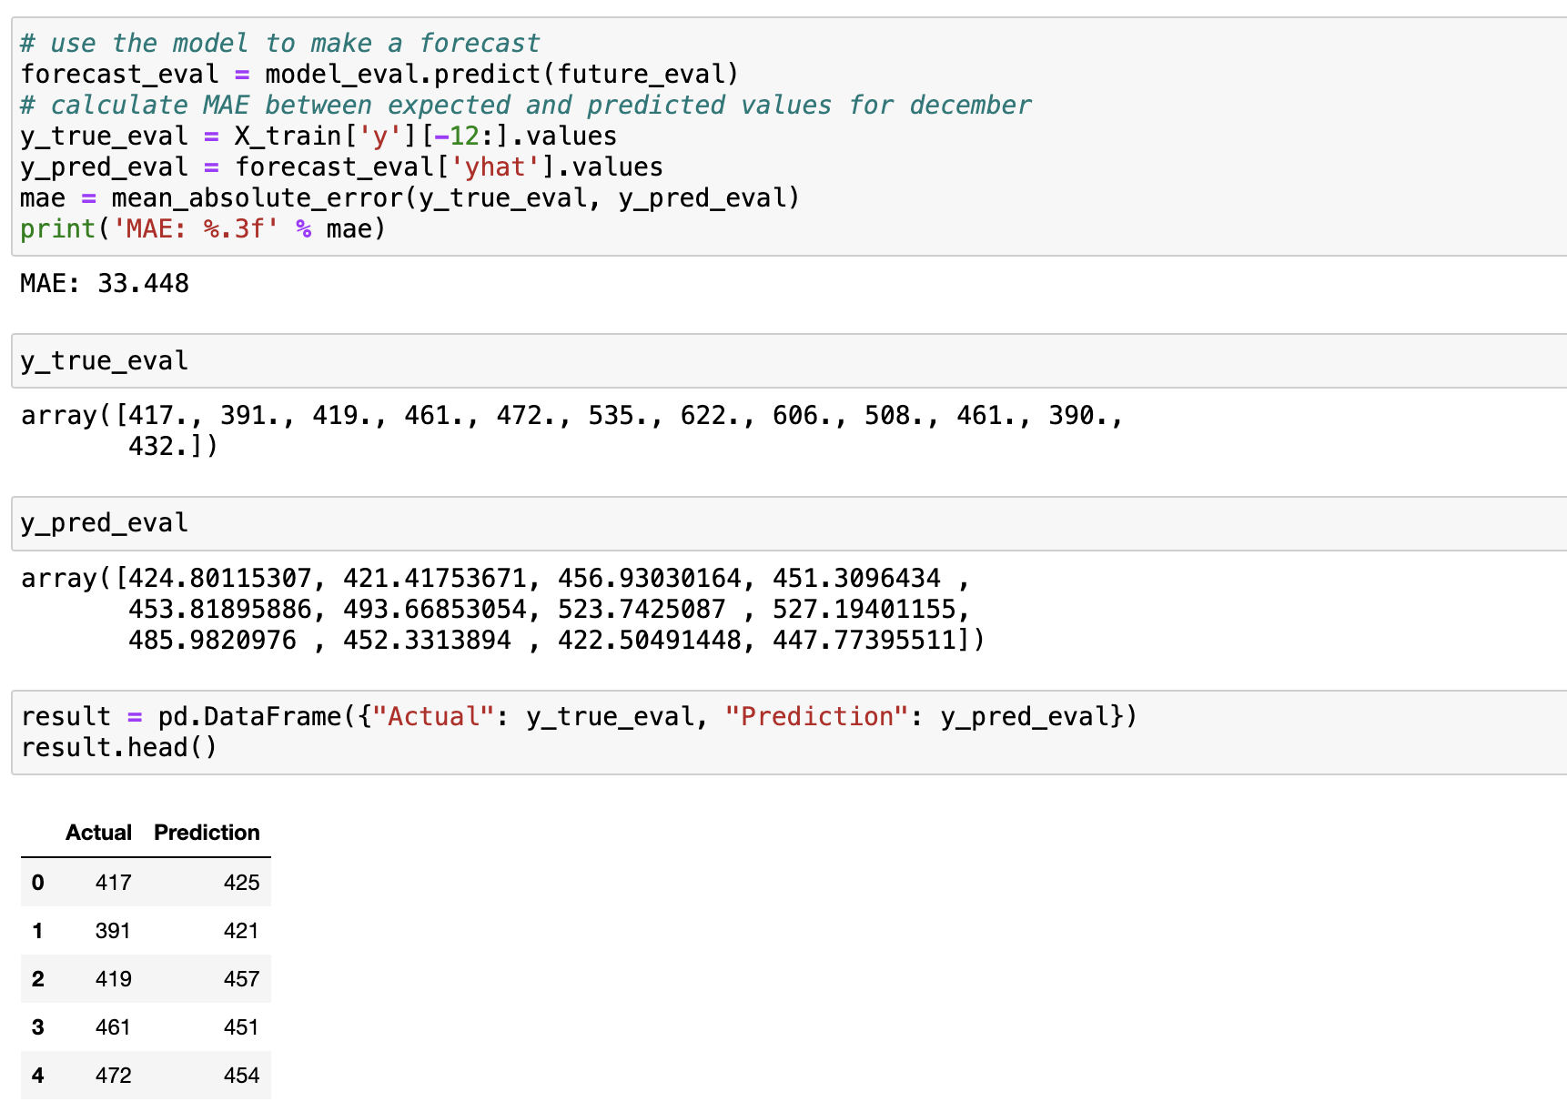
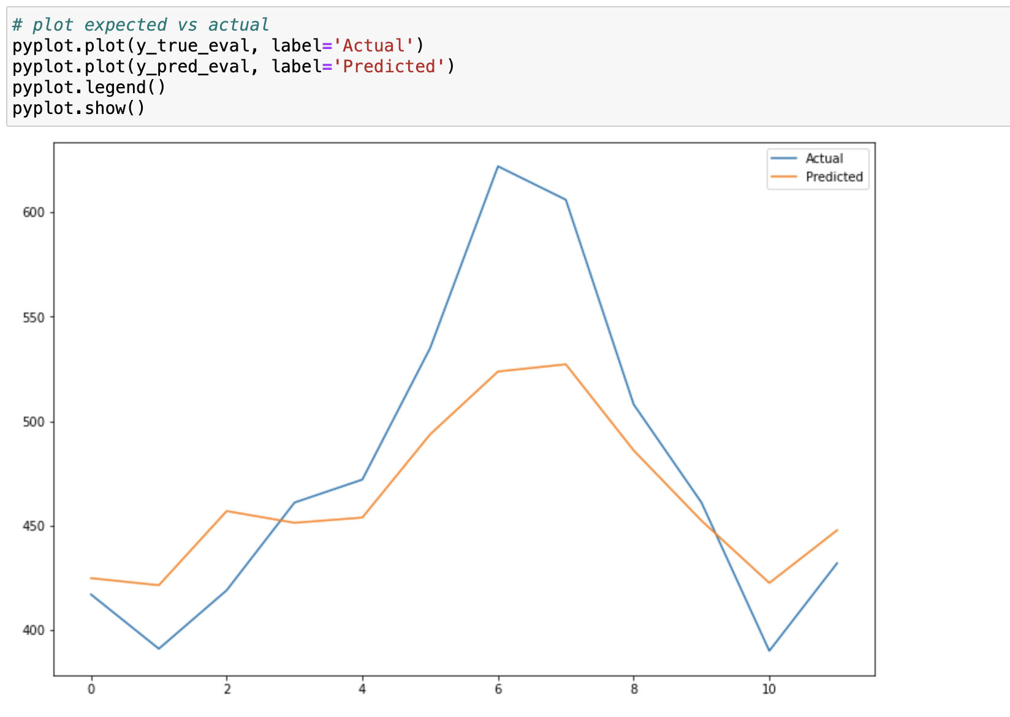
Model evaluation

Slide 12
Conclusion
Dataset contains both trends & seasonality
The number of passenger increases with the years
Time series model works adequately
Notes:
It is a standard univariate time series dataset that contains both a trend and seasonality, we observe from the plot that as years goes up the number of passengers increase, we could see peaks which could subject to trends. We are going to build a forecasting model to predict both in-sample and out-sample forecast.

Slide 13


